Slide 1
Data visualization & Analytics
Project -1-Crunch-Team

Slide 2
Safety Moment
In Case of a Fire – Who knows where the stairs are?
Answer: Go out the door , turn to the right and stairs are on your left.

Slide 3
Team Member Introductions
Fernando Figueiredo
Christopher Guthrie
Rachel Teigen

Slide 4
Our Project -Startups
Background information…

Slide 5
Data Gathering – User interface
User interface for search/queries ($)
Add information/issues on user interface
Add information/issues on user interface
Add information/issues on user interface

Slide 6
Data Gathering – API interface
org_json = req.get(query_url).json()
print("The Crunchbase API responded with: " + json.dumps(org_json, indent=2) + ".")
org_df = pd.DataFrame()
org_df["name"] = "“
oname = org_json["data"]["items"][i]["properties"]["name"]
org_df.set_value(index, "name", oname)
Issues with accessing all json structures – Crunchbase support was no help!

Slide 7
Data Gathering – Screen Scraping
browser.visit(t_url)
time.sleep(20)
soup = BeautifulSoup(html, "html.parser")
Print(soup.prettify())
for line in soup.findAll(‘Html tag’, class_=‘engagement value’)
org2_df.set_value(index, "Total Visits", line.get_Text())
https://www.crummy.com/software/BeautifulSoup/bs4/doc

Slide 8
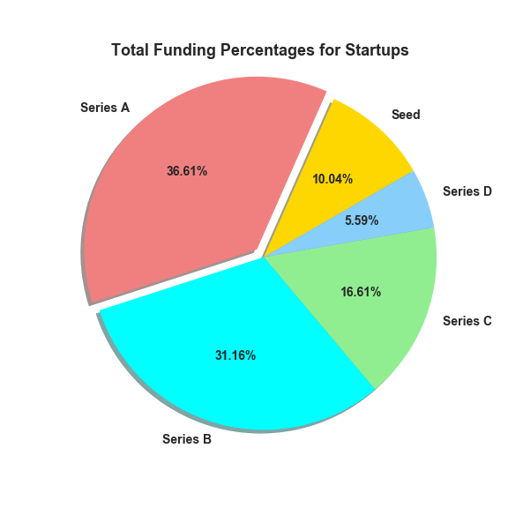
Total Funding Percentages by Type

Slide 9
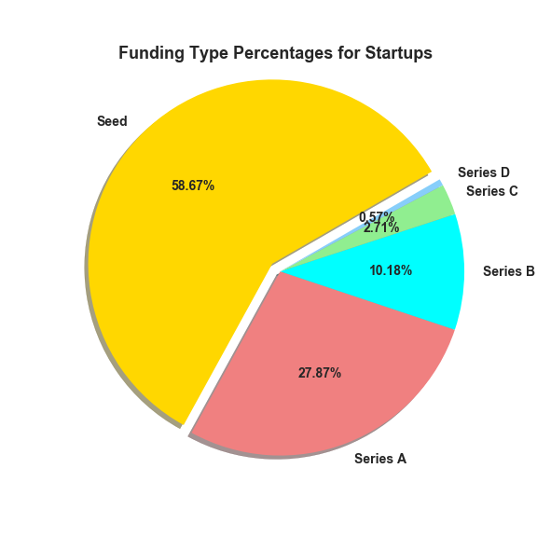
Funding Type percentages

Slide 10
Lessons Learned
Communication
Planning
Brain Storming
Questions to ask and explore…
What charts with what data…
Distributing workload
Storing and Sharing files

Slide 11

Questions

Slide 12
Appendix
Rachel had the idea when we needed one.
www.Crunchbase.com – user interface and API
www.similarweb.com – Web scraping information
www.google.com – search and file storage/sharing
www.github.com - File storage/sharing

